Slide 1
RUNGTA COLLEGE OF DENTAL SCIENCES & RESEARCH
NON PHARMACOLOGICAL BEHAVIOR MANAGEMENT
DEPARTMENT OF PEDODONTICS AND PREVENTIVE DENTISTRY

Slide 2
Slow learning objective
MUST TO KNOW
NEED TO KNOW
DESIRE TO KNOW
Hand over mouth technique
Behaviour characteristic
Communication
Factors influencing child behaviour
Use of second language
Tell-show-do
Protective stabilisation

Slide 3
CONTENTS
Introduction
Objectives
Definitions
Classifications
Factors that affect child’s behavior in dental clinic
Under the control of dentist
Out of the control of dentist
Under the control of parents
Maternal influences in personality development
Non-pharmacological behaviour management Techniques
Conclusion

Slide 4
Definitions
BEHAVIOR: It is defined as any change observed in functioning of an organism.
BEHAVIORAL PEDODONTICS: It is the study of science which helps to understand development of fear, anxiety & anger as it applies to a child in dental situations .
BEHAVIOR SHAPING: (Lenchner & Wright, 1975).
Is a procedure which slowly develops behavior by reinforcing successive approximations of the desired behavior until the desired behavior is achieved.

Slide 5
BEHAVIOR MODIFICATION:
It is defined as the attempt to alter human behavior & emotion in a beneficial way & in accordance with the laws of learning.
BEHAVIOR MANAGEMENT: (Wright, 1975)
It is defined as the means by which the dental health team effectively & efficiently performs dental treatment & thereby instills a positive dental attitude.

Slide 6
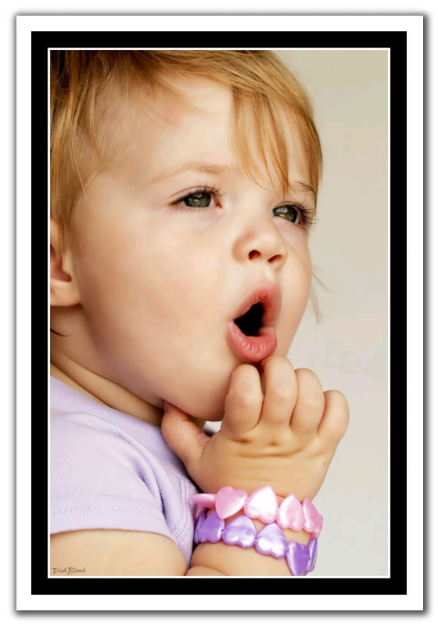
Classification
Wright :
Cooperative: Child is brave enough to face new situations, is cooperative & friendly with the dentist.
Lacking in Cooperative ability: very young children who lack cooperative abilities.
Potentially Cooperative: defiant, timid, tense cooperative

Slide 7
FRANKEL’S BEHAVIOR RATING SCALE (1962)
Rating
Behaviour
1. DEFINITELY NEGATIVE(--)
2. NEGATIVE (-)
3. POSITIVE (+)
4. DEFINITELY POSITIVE(++)
Refuses treatment, cries forcefully, extremely negative behavior associated with fear
Reluctant to accept treatment & displays evidence of slight negativism
Accepts treatment, but if had a bad experience ,may become uncooperative
Unique behavior, looks forward to &understands the importance of good preventive care.

Slide 8
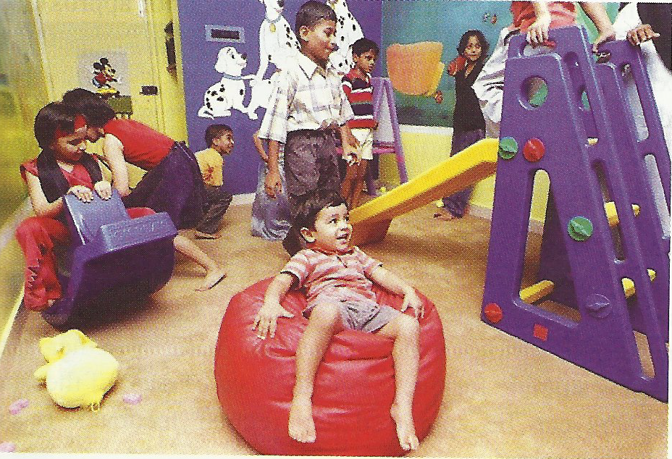
Factors Affecting Child’s Behavior In Dental Office
Under The Control of Dentist
1. Dental clinic:
Simulate a homely environment.
Operating room should be colorful & lively with posters, television, videogames.
Separate waiting room with toys, story books, & comics.

Slide 9
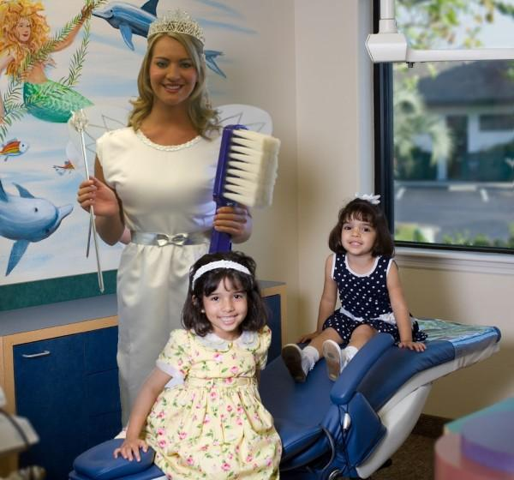
Dental auxillary should be kind & greet the child with a smile.
Appointment time should be short, less than 30 minutes.
Early morning appointments preferred for younger children.
Children should not be waiting for too long in waiting area.
Preparation of child to dental clinic is done by use of phones/pamphlets/letters.

Slide 10
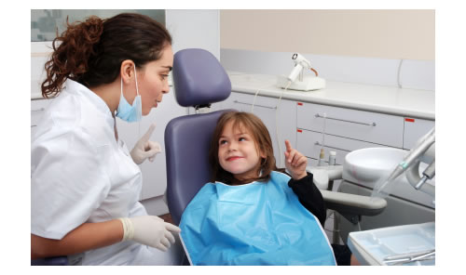
2) Effect of Dentist’s Activity & Attitudes
- Dentist Should Have A Good Impression On Child.
- Jenks (1964) described 6 types of activities.
Data gathering & observation: collecting information about a child in formal/ informal interview and observing the behavior as he steps into the office, during history taking& during procedure.

Slide 11
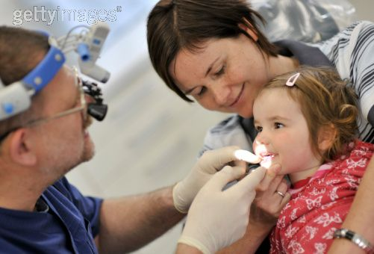
b) Structuring :By explaining the child in a language he understands, preparing him in advance for the treatment.
c) Externalization: Process by which the child’s attention is focused away from sensations associated with treatment.
2 components-
Distraction
Involvement
Object is to interest him, but should not interfere with procedure.

Slide 12
Empathy & Support: Dentist should not be totally engrossed in procedure, but respond to child’s feelings.
E.g.-
-Permitting child to express without rejection.
-Communicating that reaction is understood.
-Comforting when needed - Encouraging to show acceptable behavior
-Listening when he talks

Slide 13
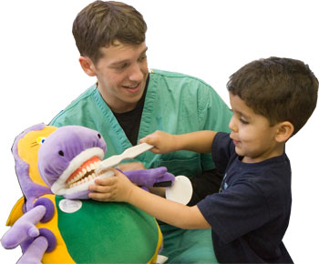
e) Flexible authority: Compromises made by dentist to meet the needs of the patient.
Educating & Training: Program to educate both child & parent to maintain good dental health.
3) Effect of Dentist’s attire:
Child with bad experience with someone in white attire, e.g. physician, would be sufficient to evoke a negative behavior.

Slide 14
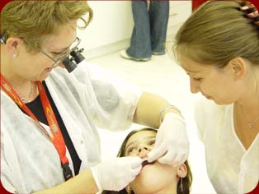
4) Presence/ absence of parents: Mother’s presence essential for a preschool, handicapped child. Older child does not require presence because of emotional independence.
5) Presence of an older sibling: Serves as a role model depending on the age of the patient.
little effect on 3 years old
No effect on 5 years old
Most noticeable on 4 years old

Slide 15
Out Of Dentist’s Control
Growth & development
If deficiency in physical growth or development or congenital malformations. E.g. cleft lip, leads to psychological trauma by society
Mentally retarded, handicapped cannot react to expectations of mother, society. Hence variation in behavior seen.

Slide 16
Nutritional factors
Increased intake of sugar causes irritable behavior.
Hypoglycemia causes criminal behavior.
Skipping breakfast leads to impaired performance.
Also affects milestones of biological & cognitive development.

Slide 17
3. Past medical & dental experiences: Unpleasant dental experiences, surgical intervention are associated with uncooperative behavior.
4. Genetics: Role in psychological development. It is modified by the environment of the child.
5. School environment: 50% school & 50% home environment.Seniors act as role models
6. Socioeconomic status: High socioeconomic status child may be a spoiled child. Low socioeconomic status child is often neglected.

Slide 18
Under The Control Of The Parents
1. Home environment:
Home is the first school.
In a broken home, child’s insecure, inferior, depressed.
Family development & peer influences:
Position/ status of child in the family.
Parental attitudes can influence child’s behavior.
Internal family conflicts leading to disharmony.
Young child follows older siblings

Slide 19
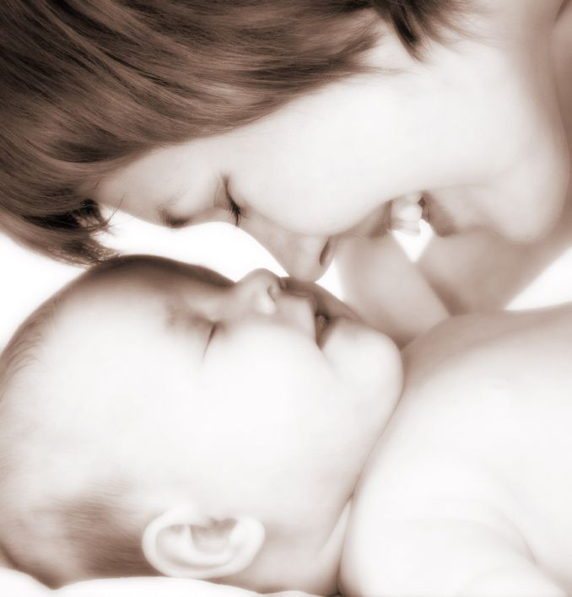
3. Maternal behavior:
Maternal influence on the child’s mental, physical & emotional development begins even before birth, i.e. postnatal behavior is linked to prenatal emotional status
Development of fetus depends on nutritional status of mother.
Agents such as alcohol/ smoking/ teratogenic drugs affect child’s development.

Slide 20
Maternal Influences On Personality Development
1. Overprotective mother:
Close relationship; both physical & emotional interdependence from birth to 4 years.
Causes- Only child
Handicapped child
Conceived after a long time.

Slide 21
Features-
Shy, submissive, anxious.
Not permitted to use his own initiative/ make his own decisions.
Child does not learn to cope with the problems & anxieties of life. Lacks self-confidence
Management-
Create self confidence
Familiarize the child with clinic, dental auxiliaries
Tell-show-do technique

Slide 22
2. Overprotective-overindulgent mother:
Features- Child is aggressive, demanding.
Displays temper tantrums if demands are not met.
Stubborn, spoilt. Used to getting their way at home.
They try to dominate over the dentist, uneasy to establish a good rapport with the child.

Slide 23
3. Under affectionate mother:
Devoid of love, care.
Neglected child.
Features- Well behaved & well adjusted.
May be unable to cooperate, shy, cries easily.
Causes-Unwanted child
Hampers mother’s career
Absent father due to divorce, death etc

Slide 24
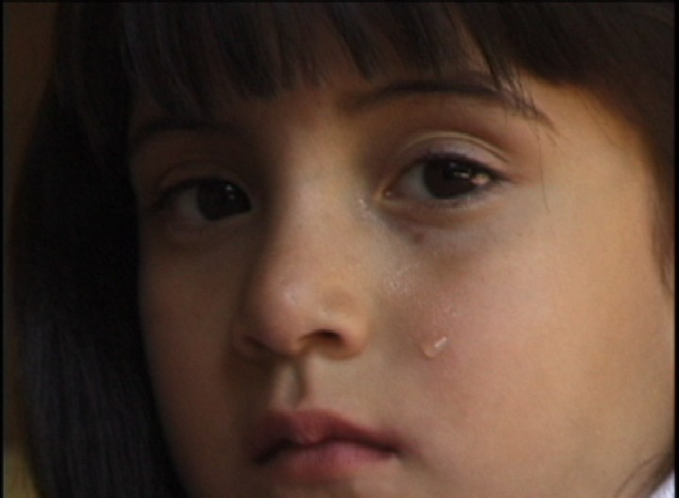
4. Rejecting mother:
Physical violence or verbal ridicule in uneducated mother.
Refusal to spend time with child.
Neglected health.
Features- Over reactive, revolting, aggressive, disobedient.
Tries to gain attention

Slide 25
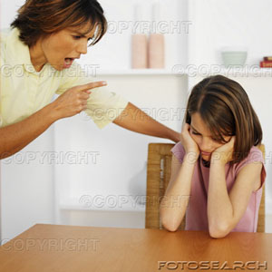
5. Authoritarian mother:
Features-Submission with resentment.
Obeys commands.
Afraid of dentist, resist dental treatment.

Slide 26
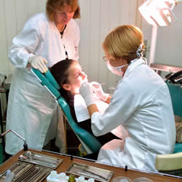
BEHAVIOR MANAGEMENT: Given by Wright (1975)
Behavior management can be classified as-
Non-pharmacological (or Psychological) approach
Pharmacological approach

Slide 27
CLASSIFICATION
NON-PHARMACOLOGICAL METHODS OF BEHAVIOR MANAGEMENT
1. COMMUNICATION
2. BEHAVIOR SHAPING ( modification)
a) Desensitizing
b) Modelling
c) Contingency Management

Slide 28
BEHAVIOR MANAGEMENT
a) Audio analgesia
Biofeedback
Voice control
Hypnosis
Humor
Coping
Relaxation
Implosion therapy
Aversive Conditioning

